Slide 1
9. [Lab6] Developing and Building IMM Application
Training Workshop for IONIC framework

Slide 2
Objectives
Learn how to use git on EC2 instance.
Learn how to run server application on EC2 instance.
Learn how to use Cordova plugin for native functions of mobile device.
Learn the process of building application for Android.

Slide 3
Contents
9.1 Running Server on EC2 instance
9.2 Implementing Pages of IMM
9.2.1 Exhibition Page, Category Page
9.2.2 Item Page
9.2.3 Search Page
9.3 Building an App for Android
9.3.1 Preparation
9.3.2 Build

Slide 4
9.1 Running Server on EC2 instance
Using GitHub for running server on EC2 instance
The Lab 5 introduces how to install git, Node.js, and MongoDB and in the Lab 2 and Lab 4, server application was created.
Server project: C:\desktop\server\example
In this section we shows how to run this server application on EC2 instance.

Slide 5
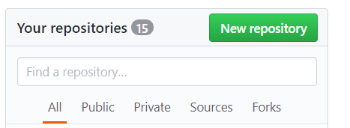
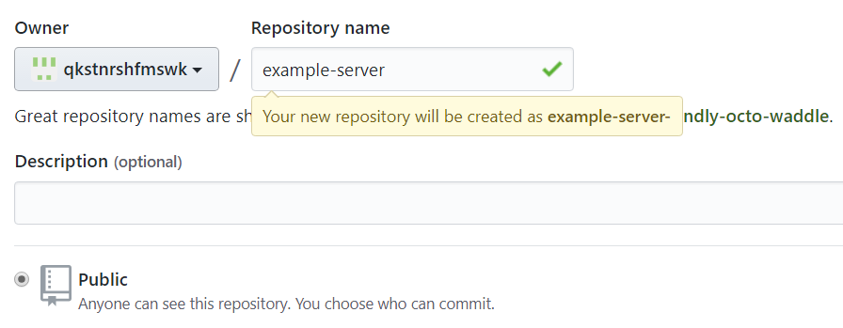
9.1 Running Server on EC2 instance
Using GitHub for running server on EC2 instance
Sign in GitHub and create repository.
The repository name is example-server.

Slide 6
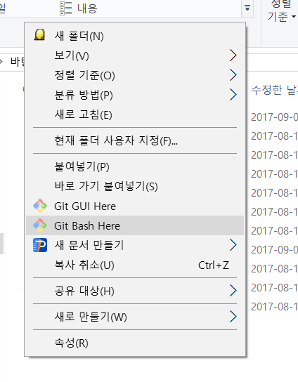
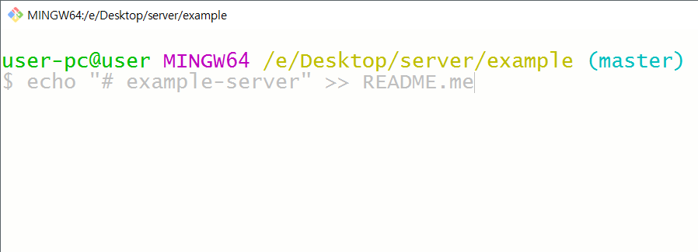
9.1 Running Server on EC2 instance
Using GitHub for running server on EC2 instance
Open server folder and execute git bash.
C\desktop\server\example

Slide 7
9.1 Running Server on EC2 instance
Using GitHub for running server on EC2 instance
Create a new repository on the command line with following commands.
% echo “# example-server” >> README.md
% git init
% git add README.md
% git commit –m “first commit”
% git remote add origin https://github.com/[user-name]/example- server.git
% git push –u origin master
% git add .
% git commit –m “commit all”
% git push

Slide 8
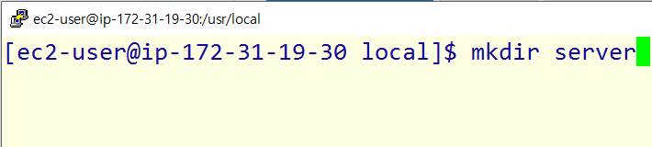
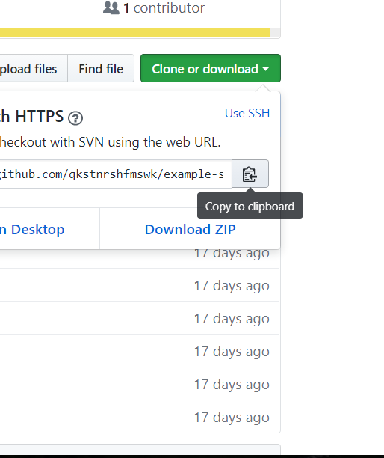
9.1 Running Server on EC2 instance
Using GitHub for running server on EC2 instance
Open putty and access EC2 instance.
Copy the URL of the repository.

Slide 9
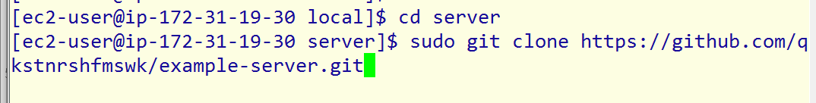
9.1 Running Server on EC2 instance
Using GitHub for running server on EC2 instance
Go to /usr/local with the command cd /usr/local.
Make new directory for the server project.
mkdir server
Go to the new folder and clone the project by using the URL.
cd server
sudo git clone [the web URL]

Slide 10
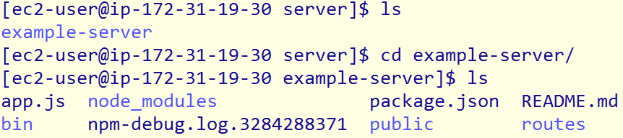
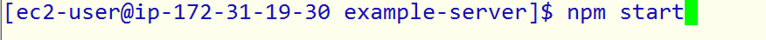
9.1 Running Server on EC2 instance
Using GitHub for running server on EC2 instance
Go to example-server folder and run server.
cd example-server.
npm start

Slide 11
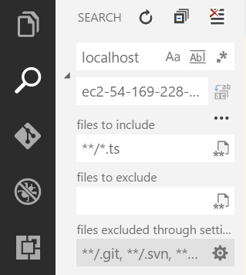
9.1 Running Server on EC2 instance
Now the server running on EC2 is used, so change the URL of APIs.
Click search button.
Enter localhost in search entry and [public DNS of EC2] in replace entry.
Click Toggle Search Details and enter **/*.ts.
Click Replace All button.
Replace All
Toggle Search Details

Slide 12
9.2 Implementing Pages of IMM
In this section, developing application starts from Ionic3API_v2 project in Tutorial_source.
Unzip Ionic3API_v2 project on desktop.
.zip file is in Tutorial_source/Lab6.
C:\desktop\Ionic3API_v2
Open the folder on visual studio code.
Run ionic serve
Ionic CLI shows message that asks whether you want to create node_modules directory or not.
Enter yes, to install moduels.

Slide 13
9.2 Implementing Pages of IMM
9.2.1 Exhibition Page, Category Page
The news page of template is used for exhibition page, category page of template is used for category page and section page and item page are generated.

Slide 14

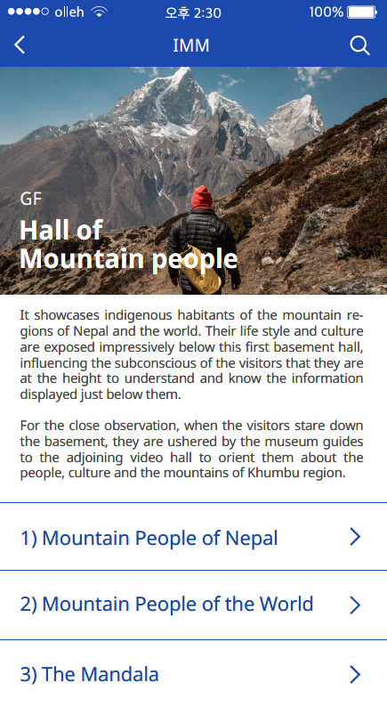
9.2 Implementing Pages of IMM
9.2.1 Exhibition Page, Category Page
Exhibition page
Category page

Slide 15
9.2 Implementing Pages of IMM
9.2.1 Exhibition Page, Category Page
Retrieving Data
Use below APIs.
URL | Method | Success Response
/exhibition-list | GET | Code : 200 Content : {{"exhibit_img": “~/public/hall_MP.png", "exhibit_name":[{"line": "Hall of"}, { "line": "Mountain people"}], "exhibit_loc": "GF", "id": "MP", "index": 1}, {"exhibit_img": "http://ec2-34-224-40-186.compute-1.amazonaws.com:3000/public/hall_WM.png", "exhibit_name":[{"line": "Hall of"}, {"line": "World Mountain"}], "exhibit_loc": "BF", "id": "WM", "index": 2}, …]

Slide 16
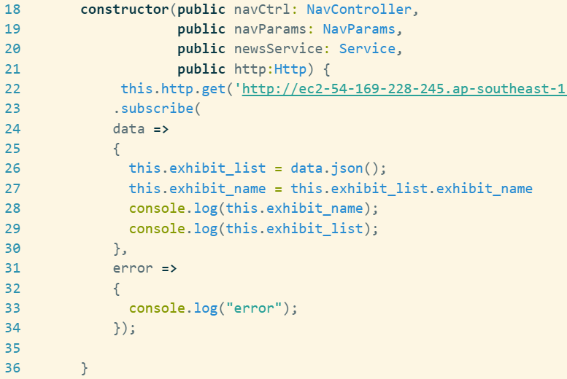
9.2 Implementing Pages of IMM
9.2.1 Exhibition Page, Category Page
Retrieving Data
Read data from server.
news.ts

Slide 17
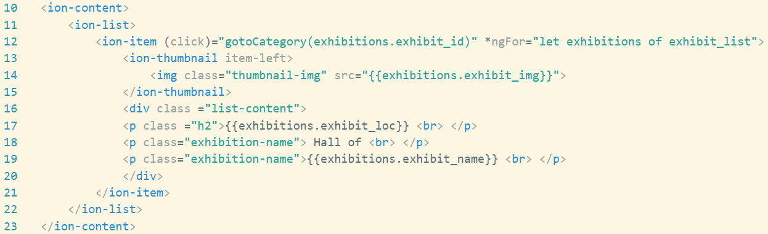
9.2 Implementing Pages of IMM
9.2.1 Exhibition Page, Category Page
Retrieving Data
Change contents
news.html

Slide 18
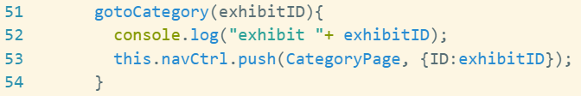
9.2 Implementing Pages of IMM
9.2.1 Exhibition Page, Category Page
Passing data between pages.
Set exhibitions.id as argument of gotoCategory function.
news.html
news.ts

Slide 19
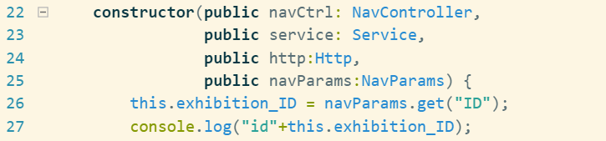
9.2 Implementing Pages of IMM
9.2.1 Exhibition Page, Category Page
Passing data between pages.
Set exhibitions.id as argument of gotoCategory function.
category.ts

Slide 20
9.2 Implementing Pages of IMM
9.2.2 Item Page
Retrieving data
Use below API
URL | Method | Success Response
/item/details/:item_id | GET | Contents: {"_id": "596c3c86e26b0c10a3ba19c6", "item_id": "A0", "item_name": "The Tamang", "item_img": "http://ec2-34-224-40-186.compute-1.amazonaws.com:3000/public/A0.jpg", "item_desc": "The Tamang are the indigenous inhabitants of the Himalayan regions of Nepal and India, their ancestral land is called Tamsaling. They are the aborigines of Yambu, or Kathmandu Valley, who had self-rule and.", "item_video": "https://www.youtube.com/watch?v=ZGjkIB_o9UQ", "category_id": "MP", "section_id": "MP_1", "subsection_id": "1", "item_hit_num": 7, "item_section": "Mountain People of Nepal Section" }

Slide 21
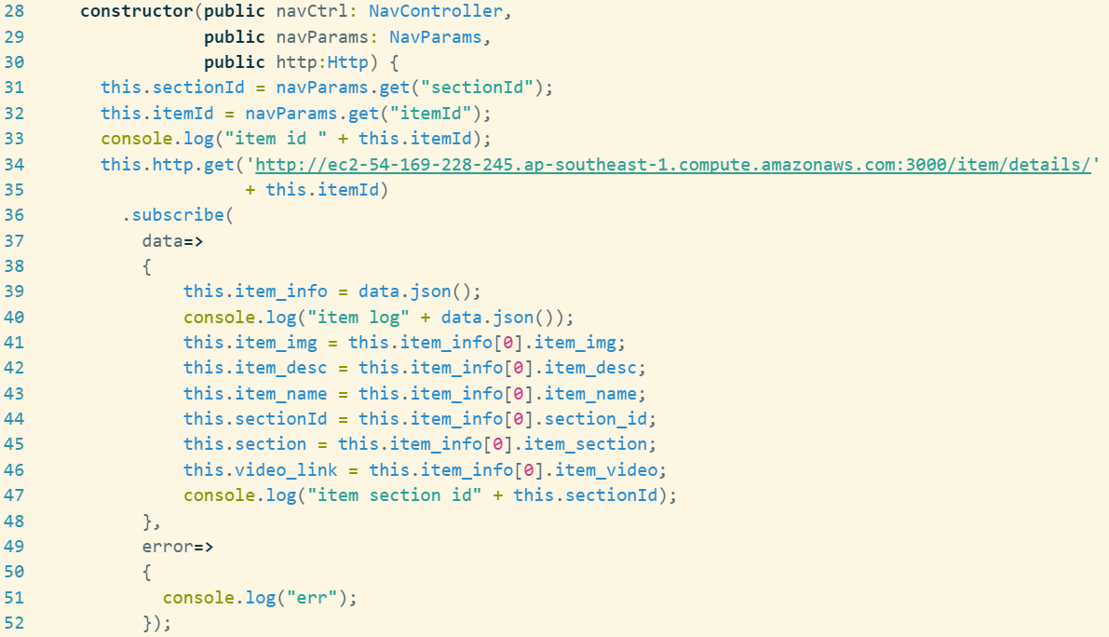
9.2 Implementing Pages of IMM
9.2.2 Item Page
Retrieving data
item.ts

Slide 22
9.2 Implementing Pages of IMM
9.2.2 Item Page
Retrieving data
item.ts

Slide 23
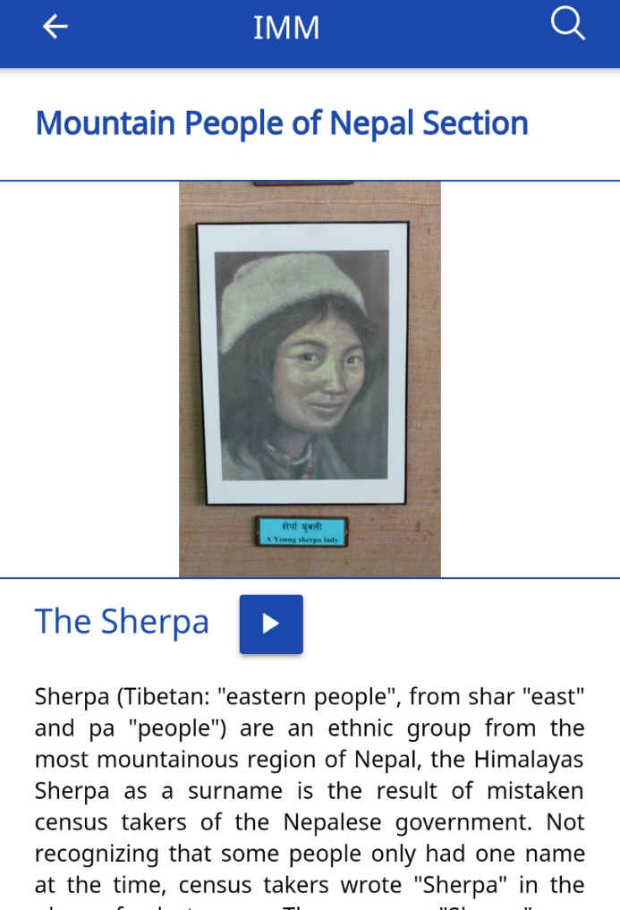
9.2 Implementing Pages of IMM
9.2.2 Item Page
Using Cordova YouTube plugin
You can use native functionality in Ionic by using Cordova plugin.
Our application need two native function-Youtube video player and QR code scanner.
(Source: https://alligator.io/ionic/youtube-video-player-ionic/)

Slide 24
9.2 Implementing Pages of IMM
9.2.2 Item Page
Using Cordova YouTube plugin
You can use native functionality in Ionic by using Cordova plugin.
Our application need two native function-Youtube video player and QR code scanner.
Install the youtube-video-player Cordova plugin:
ionic cordova plugin add cordova-plugin-youtube-video-player
npm install --save @ionic-native/youtube-video-player
at C:\desktop\ionic3API_v2\ionic3API_v2
(Source: https://alligator.io/ionic/youtube-video-player-ionic/)

Slide 25
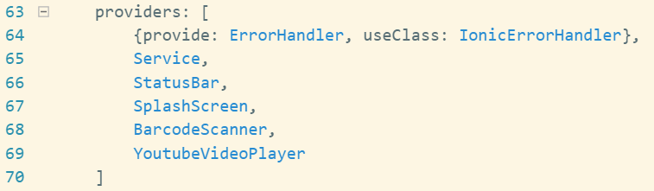
9.2 Implementing Pages of IMM
9.2.2 Item Page
Using Cordova YouTube plugin
Import youtube-video-player plugin in your component.
app.module.ts

Slide 26
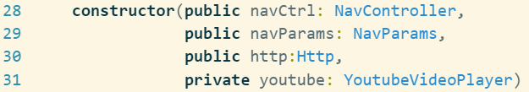
9.2 Implementing Pages of IMM
9.2.2 Item Page
Using Cordova YouTube plugin
Import youtube-video-player plugin in your component.
item.ts

Slide 27
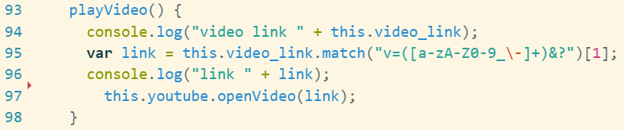
9.2 Implementing Pages of IMM
9.2.2 Item Page
Using Cordova YouTube plugin
Write playVideo function
This function extracts YouTube video ID from link and call the openVideo function.
YouTube video ID is the alphanumeric code that is unique for each video in YouTube.
It is usually embedded in myotube video link.Import youtube-video-player plugin in your component.
item.ts

Slide 28
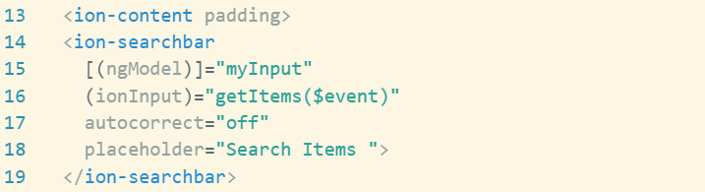
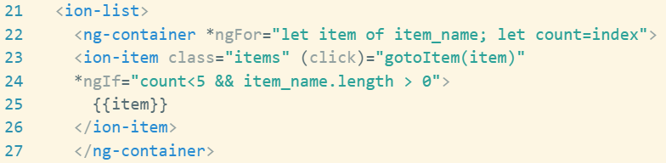
9.2 Implementing Pages of IMM
9.2.3 Search Page
Search Bar
Add search bar in to the page.
Search.html

Slide 29
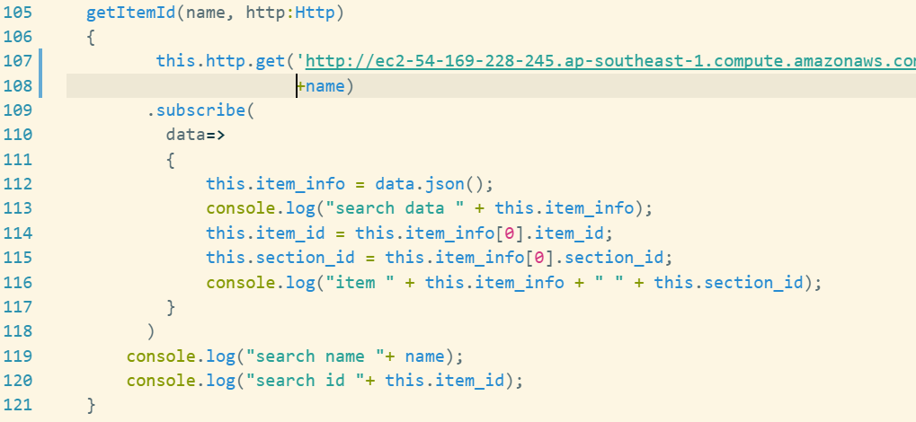
9.2 Implementing Pages of IMM
9.2.3 Search Page
Search Bar
Write getItemId function.
Search.ts

Slide 30
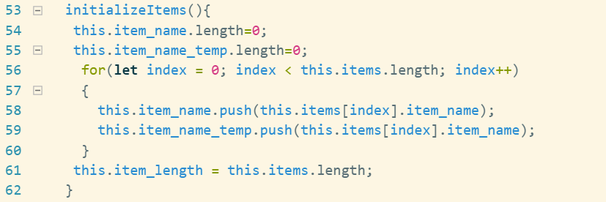
9.2 Implementing Pages of IMM
9.2.3 Search Page
Search Bar
Write initializeItems function.
Search.ts

Slide 31
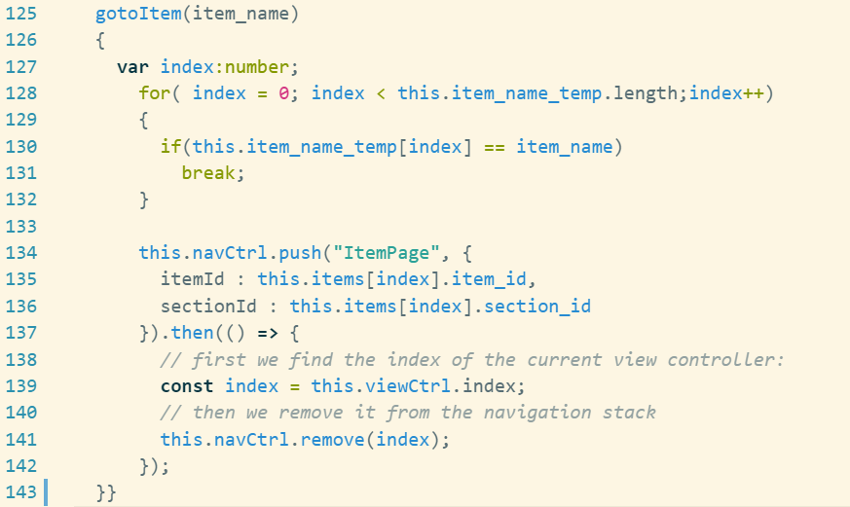
9.2 Implementing Pages of IMM
9.2.3 Search Page
Search Bar
Write gotoItem function.
Search.ts

Slide 32
9.2 Implementing Pages of IMM
9.2.3 Search Page
QR Code Scanner
To implement QR code scan function, we should use BarcodeScanner plugin
ionic cordova plugin add phonegap-plugin- barcodescanner
Run command at C:\desktop\ionic3API_v2\ionic3API_v2
Install Ionic native function
Command “npm install --save @ionic-native/barcode-scanner
Run command at C:\desktop\ionic3API_v2\ionic3API_v2

Slide 33
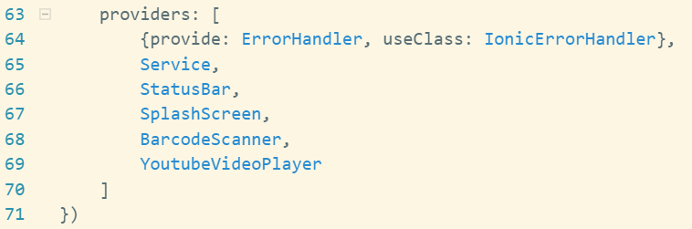
9.2 Implementing Pages of IMM
9.2.3 Search Page
QR Code Scanner
After installation, import module into app.module.ts and add to provider.
app.module.ts

Slide 34
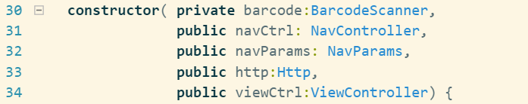
9.2 Implementing Pages of IMM
9.2.3 Search Page
QR Code Scanner
Import into .ts file and add constructor argument
search.ts

Slide 35
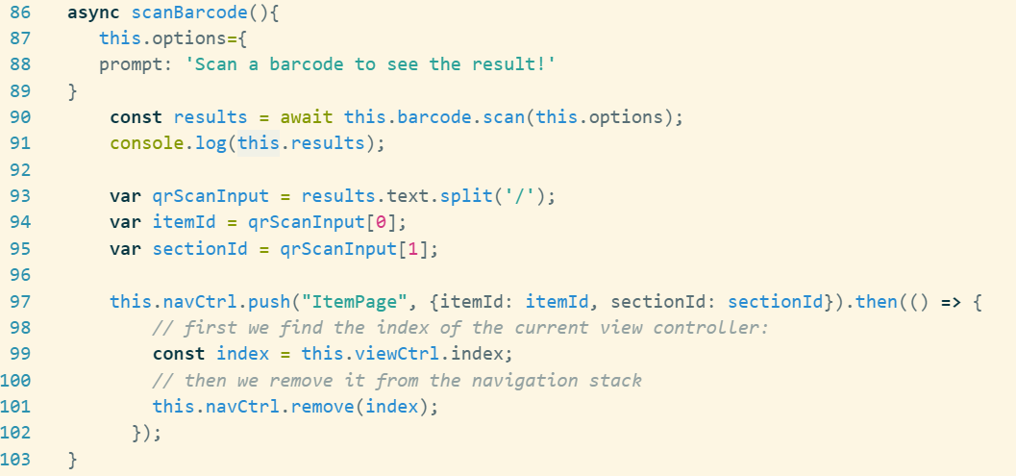
9.2 Implementing Pages of IMM
9.2.3 Search Page
QR Code Scanner
search.ts

Slide 36
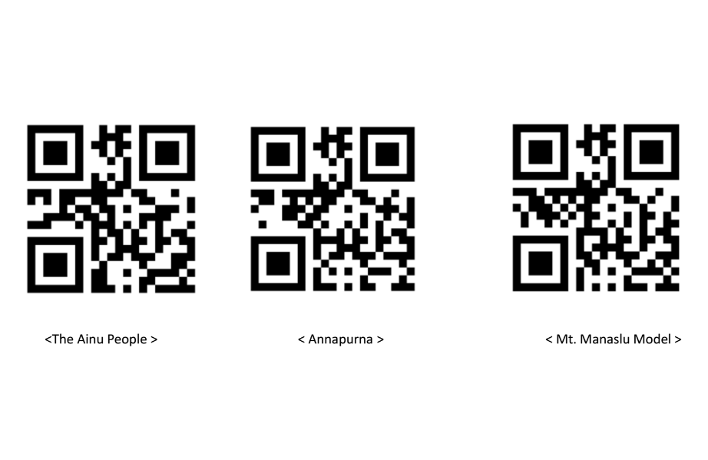
9.2 Implementing Pages of IMM
9.2.3 Search Page
QR Code Scanner
.pdf file for an example QR code is in Tutorial_source.
Tutorial_source/Lab6/qr_code_example.pdf

Slide 37

9.3 Building an App for Android
9.3.1 Preparation
Setting values
Set the widget id and app name in config.xml
Widget id is designated as UUID(Universally Unique Identifier).
config.xml

Slide 38
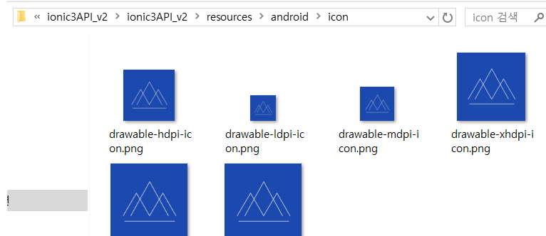
9.3 Building an App for Android
9.3.1 Preparation
Changing icon of application
Change icon images as adding images to the icon folder.
The location of icon sample image is Tutorial_source /Lab6/icon_img.
icon folder is in Ionic3API_v2/resources/android/icon

Slide 39
9.3 Building an App for Android
9.3.1 Preparation
Installing plugins
When mx.ferreyra.callnumber modules shows error 404, follow those steps.
Remove dependency in package.json.
Run this command ionic cordova plugin add call-number
Run this command
npm install --save@ioinic-native/call-number

Slide 40
9.3 Building an App for Android
9.3.1 Preparation
Installing plugins
To implement a whitelist policy for navigation the application WebView, install cordova whitelist plugin.
Install cordova whitelist plugin with the command
cordova plugin add cordova-plugin-whitelist
Write following code to whitelist the relevant domains in config.xml.
config.xml

Slide 41
9.3 Building an App for Android
9.3.2 Build
Generating .apk file
Follow these step to generate .apk file.
Build and check that android-release.apk file is generated with the command
ionic cordova build android --release
Move to location of apk file with command
cd platforms/android/build/outputs/apk

Slide 42
9.3 Building an App for Android
9.3.2 Build
Generating .apk file
Follow these step to generate .apk file.
To sign android application, keystore file should be created.
keystore file will be used to sign android application. If Android SDK is not installed on your PC, set up on your machine.
Run the following command to generate keystore file with an alias of “ALIAS”
keytool -genkey -v -keystore release.keystore -alias ALIAS -keyalg RSA -keysize 2048 -validity 10000

Slide 43
9.3 Building an App for Android
9.3.2 Build
Generating .apk file
Follow these step to generate .apk file.
To sign the unsigned APK, run the jarsigner tool which is also included in the JDK.
jarsigner -verbose -sigalg SHA1withRSA -digestalg SHA1 -keystore release.keystore android-release-unsigned.apk ALIAS
Move zipalign.exe to platforms/android/build/outputs/apk folder. The zipalign tool can be found in following path.
/path/to/Android/sdk/build-tools/VERSION/zipalign.
Run the zip align tool to optimize the APK.
./zipalign –v 4 android-release-unsigned.apk IMM.apk
(source: http://ionicframework.com/docs/intro/deploying/)

Slide 44
Summary
We used EC2 instance for running server application.
We used barcode scanner plugin for implementing QR scan function.
We generated .apk file for android.
Setting app name and widget id.
Changing app icon.
Generating private key using the keytool command.
Running the jarsigner tool.
Optimizing the APL using zipalign tool.

Slide 45








Summary
REST API
(MongoDB)
Native plugin
installation
ionic3API_v2
-npm install
-call number plugin
-BarcodeScanner
-import module
API
Build
(local)
-config.xml
-app name
-widget id
-<allow-navigation href=“*” />
-Install plugin
-whitelist
-%ionic cordova build android -release

